Slide 1
Framing the Topic: Resilient Basing
Olin Kennedy, MAJ, USA
Ian MacDonald, Capt, USAF
Jung Yae, Capt, USAF
Tyler Lucas, 1st Lt, USAF

Slide 2
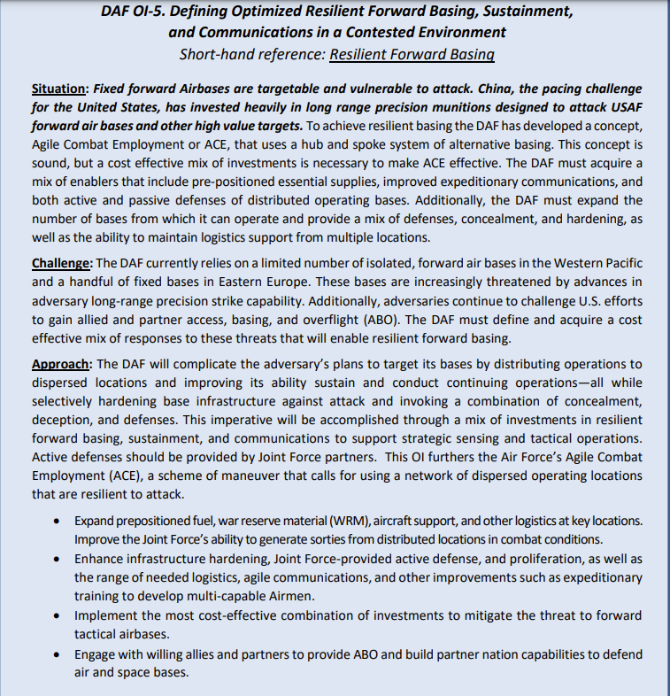
Background of the Problem Statement
Problem Prompt: How do we mitigate China’s long range precision munitions (LRPM) capability in the Indo-Pacific theater?
Importance:
LRPM makes it hard to build and preserve combat power in theatre.
ACE is a concept meant to preserve combat power against LRPM.
Assumption:
It’s desired to preserve enough combat power in the Pacific to contest China and stop an invasion of Taiwan
Challenge:
What if the cost of preserving enough combat power to do this is prohibitive in the near-term?

Slide 3
Primary Stakeholders
CSAF:
Base infrastructure and personnel vulnerable to LRPMs
Access to partner nation assets
Effective cost solution
Ability to attack in moments
Solution desired from DAF
Increase joint/multinational cooperation
Adequate Airbase coverage
ACE
Indo-PACOM:
- Command and control – clear coordination and communication lines between joint services
Provide viable COAs to the Commander in Chief
Maximize joint force lethality
Cost effective operations
Posturing to prevent adversary air and sea control
Implement innovative and experimental scenarios to counter adversary capabilities
Increase interoperability
Synergy among all sister services in Theater to achieve national war objectives.

Slide 4
Secondary Stakeholders
Secondary Stakeholders | Values
DLA | Movement of equipment, personnel, munitions and acquisition of assets
OSD CADE | Cost approval of implementation
J-Staff | Wants their equivalent Warfighter Function to be FMC
Sister Services | Force employment

Slide 5
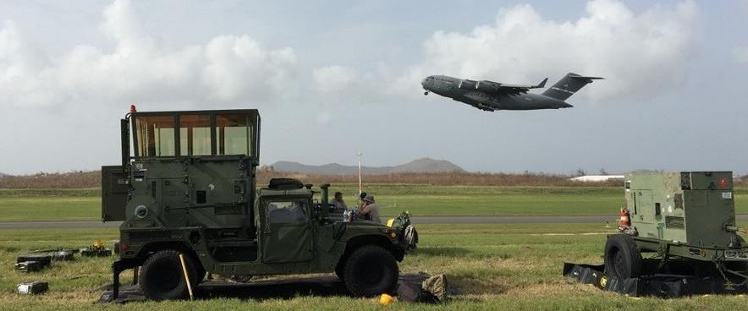
Current Literature
What is ACE?
Air Force Doctrine Note 1-21: Agile Combat Employment (23 Aug 22) Department of the Air Force Operational Imperative-5 (12 Sept 22)
With reduction in global footprint and advancement in adversarial technologies, ACE is a new basing concept to address these challenges.
ACE’s core operational elements: posture, C2, movement and maneuver, protection, sustainment, information/intelligence, and fires.

Slide 6
Current Literature
Operational Imperative: Investing Wisely to Bolster US Air Bases Against Chinese and Russian Attacks. RAND Corporation (2023)
US Air Force bases are vulnerable based on clustered runways, fuel and assets.
Advocates for an active/passive defense portfolio
Balance cost effective measures with offensive/defensive posture
Dispersion increases ability to conduct air operations while under attack
Distributed units with sufficient support are key to effective ACE
Appropriately positioned supplies, political partners and assets will drive survivability rate and effectiveness of counter attack

Slide 7
Current Literature
New Directions for Projecting Land Power in the Indo-Pacific: Contexts, Constraints, and Concepts. RAND Corporation (2022)
To Stay Relevant in a China-Focused Scenario, this study suggests that the Army ought to become a “Battlefield Enabler” and “Information Multiplier” to the joint force
Air Base Defense: Rethinking Army and Airforce Roles and Functions. RAND Corporation (2020)
The misalignment of service responsibilities and priorities for air base defense is hindering the correction of enduring shortfalls.

Slide 8
Current Literature
Arrol, Matthew, (2022) “The Key to Maximizing the Air Force’s Agile Combat Employment Concept? The Army” Modern War Institute at West Point.
Air Force and Army should work more closely together to build ACE.
Joint investment will enhance defense of forward bases.
Lessons from Ukraine should be used to improve implementation.

Slide 9
Framework: Resilience to LRPM Attack
Air Force Resilience to LRPM
Cost w/out Joint/Multinational Considerations
Joint / Multinational
Lower the cost of ‘adding bases’ by using existing facilities from Joint/Multinational Partners
Increase interoperability
Maximize joint force lethality
Cost of Building New Bases
Cost
Cost of Building New LRPMs
Flexibility
Cost
Army Point Defense
Joint Doctrine
C2
Number of Bases
Improve Existing Base Infrastructure
Acquisitions
Cost + Joint/Multinational Considerations
AF ADA
Training/Doctrine/Force Structure
Innovative Combat Support Systems
Ability to attack in moments
Cost of Using
LPRM Missiles
Cost +
Diplomatic Cost
Cost of Co-opting
Existing Bases
*Diplomatic Cost
Number of Bases

Slide 10
Questions?
Notes:
How the stakeholders view the problem
What is ACE
How have we executed this?
Then current literature

